Slide 1
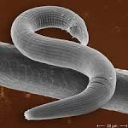
Nematoda
The Roundworms الديدان الخيطية
General Characteristic
Threadlike “worms” covered by a thick cuticle.
Un-segmented, cylindrical, bilaterally symmetrical
Have a complete digestive tract with both oral and anal openings
They are long-lived (1-30+ years)
Most nematodes are dioecious and males are smaller than females
Adult anterior- may have hooks, teeth, or cutting plates in the buccal cavity

Slide 2
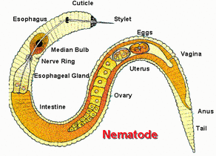
Nematoda
Have complete reproductive organs
Males have testes, vas deferens, seminal vesicle and an ejaculatory duct Females have ovaries, oviduct, seminal receptacle, uterus and vagina Both free-living and parasitic
Vary greatly in size- from a few millimeters to over a meter.
Male worms - frequently have a curved or coiled posterior end with copulatory spicules; Some species exhibit a copulatory bursa

Slide 3
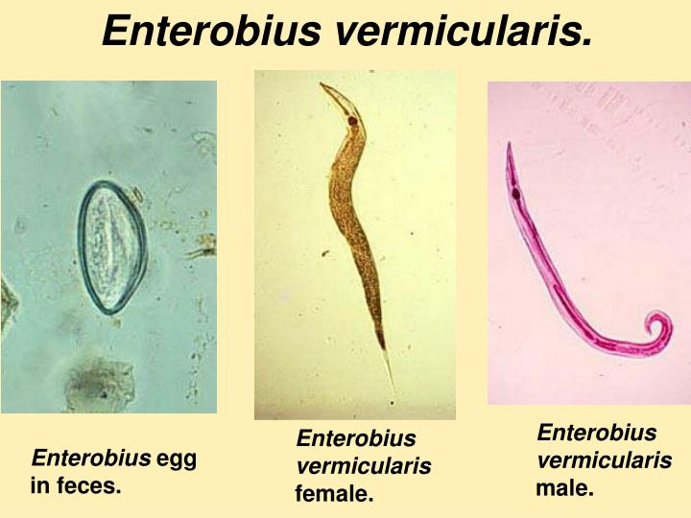
Enterobius vermicularis
Common name: Pinworm or seat worm
Location: Cecum in human
Morphology: Adult female worms are up to 10 mm in length, and male worms are up to 5 mm. Eggs are transparent and colourless, asymmetrical, with thin and smooth membrane, 40-60 micron
Disease: Enterobiasis
Host: man.
Infective stage: Egg
Diagnosis: Eggs with D shape

Slide 4
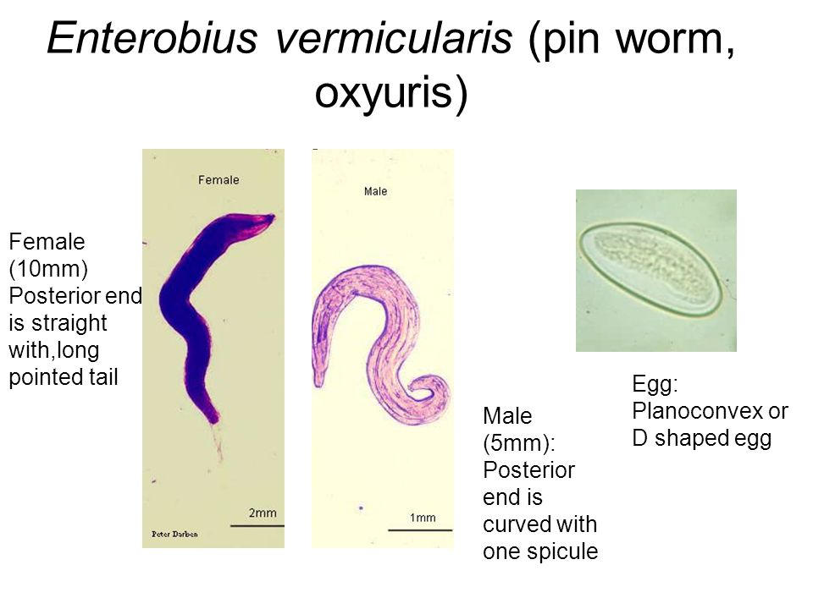

Slide 5
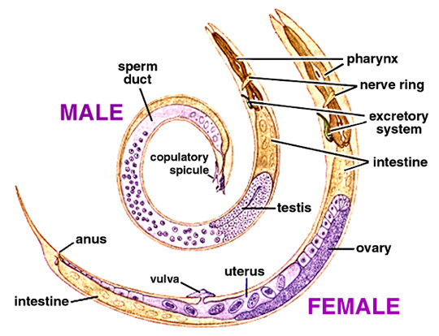
Ascaris lumbricoides
Disease: ascariasis
Common name: Abdominal snake
Infective stage: egg
Diagnosis: Fertilized and unfertilized egg

Slide 6
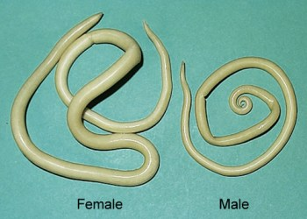
Ascaris lumbricoides
Morphology: Adult worms are creamy or pink, spindle-shaped, covered by striated cuticle. Adult male about 20 cm in length, posterior end curved ventrally, adult female about 25-40 cm in length, posterior end straight. Eggs are brown, oval, covered by membranes. An external membrane is tuberous.
Host: man

Slide 7
Mode of transmission: faecal-oral (alimentary).
Localisation: small intestine (adult), liver, lungs, heart (larvae).

Slide 8
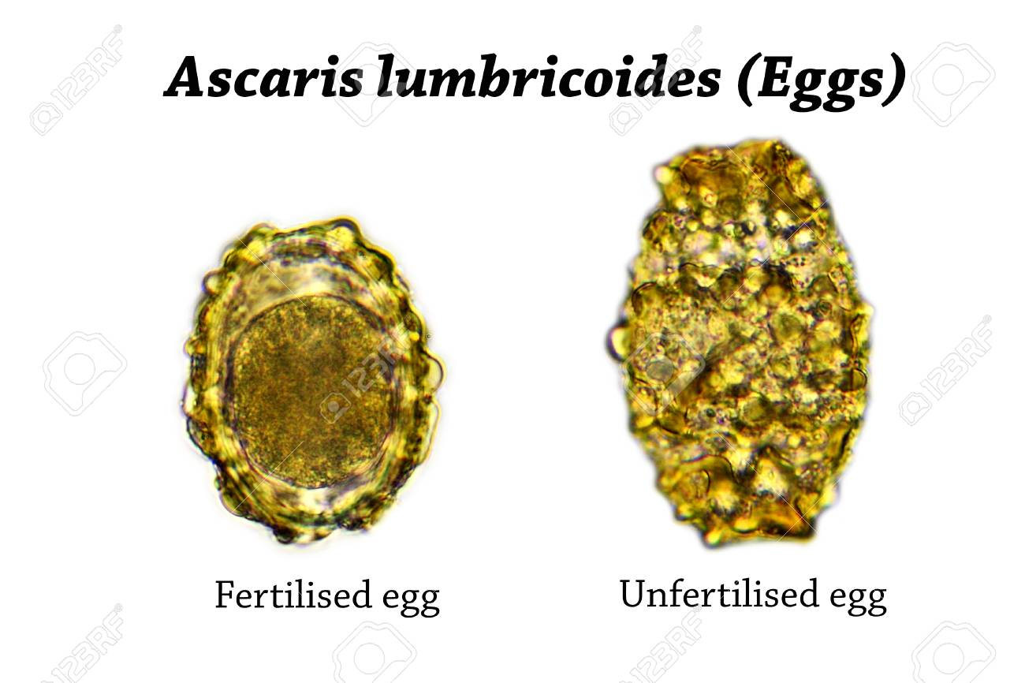
Fertilized eggs | Unfertilized egg
broad oval in shape The shell is thicker and consists of, proteinaceous layer, vitelline layer, chitinous layer, lipid layer. The content is a fertilized ovum | Longer and slender than a fertilized egg. The chitinous layer and proteinaceous coat are thinner than those of the fertilized eggs. The content is granules various in size.

Slide 9
Prophylaxis:
washing hands before meals; proper washing of vegetables eaten raw; treatment of patients; health education.

Slide 10
